Slide 1
Making Dietetics Work for You!
Notes:
Hi! My name is [NAME]. I work as [EXPLAIN POSITION AND TITLE]. I’m also a member of the Academy of Nutrition and Dietetics and a Diversity Liaison for [ACADEMY GROUP]. Today, I’m going to be talking to you about the exciting field of food, nutrition and dietetics. As you continue with your studies, you may decide that the food, nutrition and dietetics field is right for your future career. But, what exactly is the nutrition and dietetics field and how can you get into it? During my presentation today, I will highlight just some of the various roles, positions and professions that are all part of the dietetics field. We’ll also review where you can find more information to get started through the Academy of Nutrition and Dietetics. Okay! Let’s get underway.

Slide 2
Get to Know the Speaker
Notes:
[PERSONALIZE SLIDE BASED ON YOUR POSITION AND SPECIALITY IN THE FIELD] Again, my name is [NAME]. [EXPLAIN WORK SETTING, POSITION, TITLE, ORGANIZATION YOU WORK FOR. HIGHLIGHT DIFFERENT POSITIONS YOU’VE HELD. KEEP THIS SLIDE TO UNDER 2 MINUTES AS THIS SHOULD ONLY BE HIGHLIGHTS OF YOUR CAREER – TAILOR TO AUDIENCE AS NEEDED.]

Slide 3
What is Dietetics?
Dietetics is the science and art of applying the principles of food and nutrition to health.
Those in the field include:
Registered dietitian nutritionists (RDNs)
Nutrition and dietetics technician, registered (NDTRs)
Notes:
Many of you might be thinking, what is dietetics? Dietetics is the science and art of applying the principles of food and nutrition to health. Dietetics is using science, research and data to best understand how nutrition and food can help us live healthier lives. Registered dietitian nutritionists, or RDNs, [PERSONALIZE THIS SECTION AS NEEDED TO HIGHLIGHT YOUR ROLE] help patients select the best foods to fit their needs. This includes patients looking to manage their diabetes, to athletes looking to maximize their athletic performance.
(Definition found: http://www.eatrightpro.org/resources/about-us/become-an-rdn-or-dtr)

Slide 4
Why Dietetics?
Here are a couple reasons to consider entering this line of work:
It’s a growing field
People are living longer
Flexibility
Make a difference
What’s your reason?
Notes:
[IF YOU ARE PRESENTING TO STUDENTS AND NEED TO EXPLAIN THE FIELD]
The Bureau of Labor Statistics predicts the most employment growth by the year 2026 will be among health care support jobs. They also predict the profession of nutrition and dietetics to grow by 14% over that time, faster than the average profession. Since people in US are living longer lives, the health care industry will need to expand to support them.
Working in the health care industry, particularly dietetics, will also offer you a lot of flexibility. You could work as a dietitian or dietetic technician in a hospital, you could work in sports or with athletes, in restaurants or supermarkets, with underserved populations, in schools, or you could run your own practice. And most importantly, by educating people to make nutritious decisions and live healthier lives, you will be helping people and making a difference in the world.
[INSERT A PERSONAL STORY HERE TO DESCRIBE WHY YOU WENT INTO DIETETICS]

Slide 5
Who Are We?
The Academy was founded in 1917 and is the world’s largest organization of food and nutrition professionals.
Notes:
What brings RDN, NDTRs and those in allied health professions together to support healthy eating? Well, that’s the Academy of Nutrition and Dietetics. The Academy is the organization for food, nutrition and dietetics professionals. Let’s take a closer look at what the Academy is and how you might get started in the profession.
The Academy was founded in 1917 by a visionary group of women dedicated to helping the government conserve food and improve the public's health and nutrition during World War I . Since the early 1900s, the Academy has blossomed into the world’s largest organization of food and nutrition professionals, with members throughout the United States, as well as in 80 countries. Members come from a variety of professional backgrounds and locations across the globe. I’ve been a member since [ENTER THE YEAR OR PROVIDE AN IDEA OF HOW LONG YOU’VE BEEN AN ACADEMY MEMBER] and have found membership to [PERSONALIZE AS NEEDED].

Slide 6
Who Are We?
Vision
A world where all people thrive through the transformative power of food and nutrition.
Mission
Accelerate improvements in global health and well-being through food and nutrition.
Notes:
So, what does the Academy do? And, why do those in the food, nutrition and dietetics field join the Academy? Well, as I mentioned before, dietetics is the science and art of applying the principles of food and nutrition to health. Or, in other words, using nutrition research and data to help patients, clients and the public lead healthier lives. The Academy embraces this philosophy and, through it’s mission and vision, supports those in the field. This support includes conducting and funding nutrition research, providing profession-wide standards, offering educational opportunities and connecting those in the field to each other. For those looking to start their careers in nutrition, the Academy also provides information on how to enter the field. Let’s take a closer look.
[INCLUDE ANY PERSONAL REMARKS ABOUT THE ACADEMY – HOW YOU BECAME INVOLVED, HOW YOU LEARNDED WHAT THE ACADEMY DID, ETC.]

Slide 7
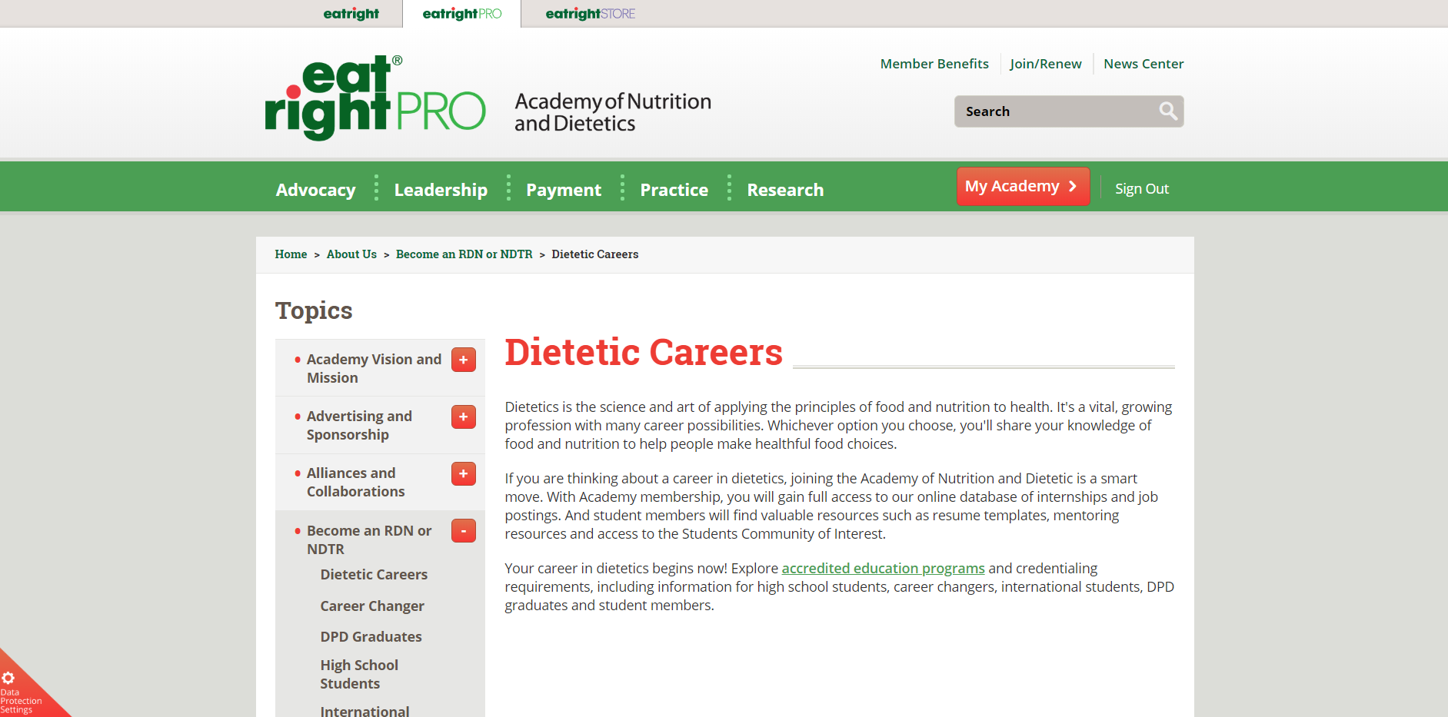
www.eatrightPRO.org
Notes:
[IF YOU ARE PRESENTING TO STUDENTS AND NEED TO EXPLAIN HOW TO ENTER THE FIELD]
As you begin to consider your future career, be sure to check out the Academy’s professional site: www.eatrightPRO.org. On this site you can learn about how to become an RDN or NDTR, as well as the educational programs that can help you enter the field. Plus, if you know you are interested in entering the field, you may qualify to become a Student member of the Academy, which will provide you with access to a range of benefits to help you get a jump start on your career.

Slide 8
www.eatrightACEND.org
Notes:
[IF YOU ARE PRESENTING TO STUDENTS AND NEED TO EXPLAIN HOW TO ENTER THE FIELD]
For those of you considering a career in dietetics, you can also check out www.eatrightacend.org. On this site, you will find a list of educational programs for associate, baccalaureate and master levels that can help you get into the field. In order to become an RDN or NDTR, you will need to graduate from one of these programs. In addition, becoming an RDN or NDTR requires passing a specialized exam. Those electing to pursue the RDN must also complete a practice-based experience typically referred to as an internship. Becoming an RDN or NDTR is the clearest pathway into the nutrition and dietetics field. However, as I mentioned earlier, the field of nutrition and dietetics includes those in a variety of fields – from chefs to food scientists to doctors and nurses.

Slide 9
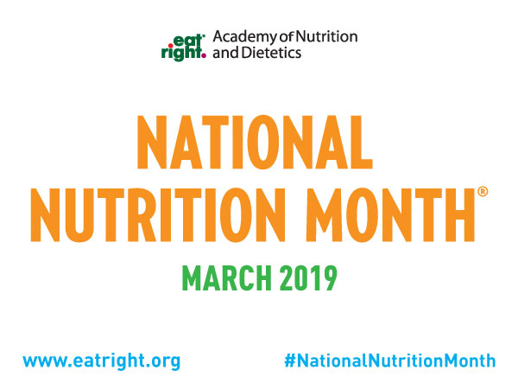
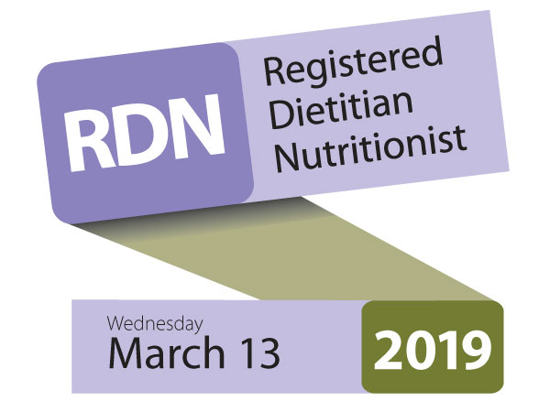
National Nutrition Month and Registered Dietitian Nutritionist Day
Notes:
Every March is National Nutrition Month (NNM), which is the annual nutrition and education recognition month sponsored by the Academy. The campaign is designed to focus attention on the importance of making informed food choices and developing sound eating and physical activity habits. NNM also promotes the Academy and its members to the public and the media as the most valuable and credible source of timely, scientific-based food and nutrition information.

Slide 10
Shaping Public Policy
Taking Action By:
Influencing the direction of legislation
Testifying on Capitol Hill
Developing grassroots advocacy
Policy Focus Areas:
Disease prevention and treatment
Lifecycle nutrition
Healthy food systems and
access
Quality health care
Notes:
The Academy has two offices: the main headquarters in Chicago, IL, and a smaller office in Washington, D.C. Our office in Washington advocates for better nutrition policies and represents member interests in legislative and regulatory issues. The Academy shapes public policy by taking action through the direction of legislation, testifying on Capital Hill and developing grassroots advocacy. In addition, the Academy’s public policy focus on three main areas:
Disease prevention and treatment, including cancer, cardiovascular health, diabetes and pre-diabetes, HIV/AIDS, obesity and weight, and access to healthcare.
Lifecycle nutrition, including prenatal and maternal health, early childhood nutrition, school-age students and nutrition for older adults.
Healthy food systems and access, including access to safe food supply and increasing participation in nutrition programs and development of food safety and food delivery systems.
Quality health care, including health care equity, consumer protection and licensure, workforce demand, research and monitoring, lowering health care costs and quality measures.
Academy members help further public policy for the public’s overall health as an extension of the work members are doing in their everyday lives.

Slide 11
FNCE
Food & Nutrition Conference & Expo (FNCE)
Philadelphia, PA
October 26-29, 2019
Notes:
Has anyone attend FNCE? The annual Food & Nutrition Conference & Expo (FNCE) is the biggest event in dietetics. Students and professionals gather once a year to attend, and the location changes every year. In 2019, join us in Philadelphia! FNCE provides great opportunities to make connections with students and dietetics professionals. You can explore the Expo Floor, which showcases all the newest breakthroughs in food and nutrition, and learn from hundreds of educational sessions designed just for you.

Slide 12
Making Connections
Affiliate Dietetics Associations
50 states, District of Columbia, Puerto Rico, American Overseas
Dietetic Practice Groups
Professional Interests
Member Interest Groups
Common Interests
Notes:
Included with Academy membership is membership in a state affiliate of your choosing. Affiliate membership connects dietetics students and professionals on the local level, and is a great way to grow the dietetics community around you. Also available with Academy membership is the option to join dietetic practice groups (DPGs), which connect people based on professional interests, or member interest groups (MIGs), which connect people based on demographics or backgrounds. Let’s take a closer look at DPGs and MIGs.
[PERSONALIZE SLIDE WITH YOUR AFFILIATE’S LOGO]

Slide 13
Making Connections
Dietetic Practice Groups
Sports, Cardiovascular & Wellness Nutrition
Nutrition Education for the Public
Vegetarian Nutrition
Weight Management
Member Interest Groups
Latinos and Hispanics in Dietetics and Nutrition
Cultures of Gender and Age
National Organization of Blacks in Dietetics and Nutrition
Notes:
As I mentioned, members have the exclusive ability to join DPGs or MIGs to further connect in the field. Many of the Academy’s over 20 groups have online access, webinars and exclusive benefits. As an Academy member, you can join these groups for a small additional fee. These groups focus on practice areas as well as interest areas. I’ve highlighted a few here, but this is only a small handful of the various specialty areas where you can gain additional knowledge, professional resources and make connections to those in the field from all over the world. [PERSONALIZE AS NEEDED]

Slide 14
Academy Members
Notes:
So far we’ve reviewed the various ways you can have a career in food, nutrition and dietetics, where to find information on how to get into the field, and what the Academy of Nutrition and Dietetics, as the world’s largest organization of food and nutrition experts, is doing to help the public’s health through delivering a wealth of benefits and services to its members. Now let’s take some time to discuss how you can become a member of the Academy and what the benefits of membership are.

Slide 15
Joining the Academy
Students - $58
Are you enrolled in an educational program approved by the Accreditation Council for Education in Nutrition and Dietetics (ACEND)?
Do you intend to enroll in an educational program approved by the Accreditation Council for Education in Nutrition and Dietetics (ACEND)?
Are you enrolled in a master’s or doctoral program related to food, nutrition or dietetics?
Notes:
As I’ve gone through the presentation today, you might be asking yourself, how do I become a member? There are three ways to become a Student member of the Academy. If you can answer ‘yes’ to any of the questions above, you most likely qualify for Academy Student membership.
Let’s take a moment and walk through these questions.
Are you enrolled in an educational program approved by the Accreditation Council for Education in Nutrition and Dietetics (ACEND)? ACEND is the organization that accredits dietetics educational programs. Programs are available at the associate, bachelor’s or master’s level. To find a list of ACEND programs, visit www.eatrightacend.org. I also have this website listed at the end of the presentation if you would like to write it down. For those considering becoming an RDN or DTR, you’ll want to highly consider attending an ACEND-approved program.
Do you intend to enroll in an educational program approved by the Accreditation Council for Education in Nutrition and Dietetics (ACEND)? If you intend to enroll in an ACEND program, you can become an Academy Student member. This may be the case if you decide to take classes at a community college and then later attend an approved dietetics program at a four year university. [POSSIBLE TAILOR BY INCLUDING LOCAL COLLEGES.] Or, if you are in high school and have not yet selected a college, but intend to enroll in an approved school, you may also join as a Student member.
Are you enrolled in a master’s or doctoral program related to food, nutrition or dietetics? Those who pursue advanced degrees beyond a bachelor’s, such as a master’s or doctoral degree in a related food, nutrition or dietetics concentration may apply for student membership.

Slide 16
Joining the Academy
Active - $234
Do you hold a degree from a dietetics program accredited by the Accreditation Council for Education in Nutrition and Dietetics (ACEND)?
Are you eligible to sit for the RDN or NDTR exam administered by the Commission on Dietetic Registration (CDR)?
Do you hold a master’s or doctoral degree, and any one degree is in a dietetics related field?
Notes:
[ONLY USE SLIDE IF SPEAKING TO THOSE TRAINSITIONING INTO THE PROFESSIONAL WORLD OR PERHAPS ALREADY WORKING] For those looking to study in the food, nutrition and dietetics areas, once you start working in the field, you will most likely qualify for Active membership. To help you figure out if you qualify, ask yourself these three questions. If you can answer ‘yes’ to one of these questions, then you qualify.
Do you hold a degree from a dietetics program accredited by the Accreditation Council for Education in Nutrition and Dietetics (ACEND)?
Are you eligible to sit for the NDTR or RDN exam administered by the Commission on Dietetic Registration (CDR)?
Do you hold a master’s or doctoral degree, and any one degree is in a dietetics related field?

Slide 17
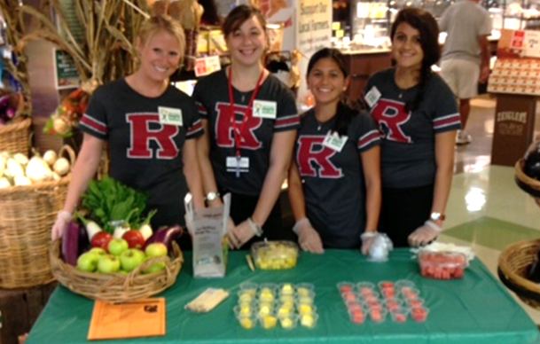
Student Members
Notes:
[IF YOU ARE PRESENTING TO STUDENTS]
Student members of the Academy have exclusive access to member benefits that help them get a head start on their career and make a difference in the health of the public. Student members can also apply for scholarships for school and receive a bi-monthly e-newsletter, Student Scoop. Additionally, through student dietetics clubs at their university or college, Student members create a variety of programs that bring nutrition information out of the classroom and into the lives of their fellow students and community. Some past student club activities have included meal preparation with middle school students, nutrition education with elementary school students, and healthy snacking ideas for college students. As members of their college club, students have the opportunity to serve in leadership positions, and may apply to serve as Student Liaisons with the Academy, which can then be highlighted in future job interviews or on resumes.

Slide 18
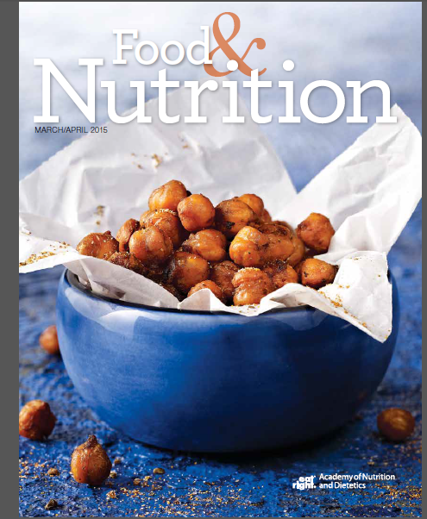
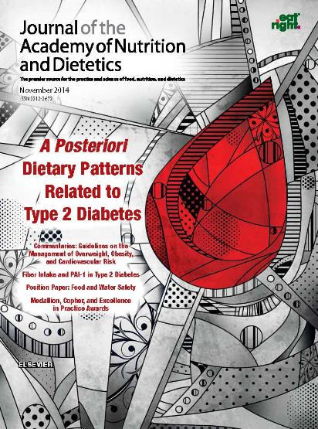
Increase Your Knowledge
Free subscriptions to the Journal of the Academy of Nutrition and Dietetics and Food & Nutrition Magazine.
Notes:
Now that you know the qualifications of membership, let’s take a look at some of the direct benefits of Academy membership.
Through the Academy, members have access to a variety of resources to help you stay knowledgeable and up-to-date in the field. The Academy’s two main publications, the Journal of the Academy of Nutrition and Dietetics and Food & Nutrition Magazine, do just that by providing professional and career advancement resources including recipes, food trends, reviews of popular food publications and apps, as well as research in areas such as diabetes and weight management. Student members will receive online only access to the Journal, but may purchase the print version by signing up for the Student Plus option by calling the Member Services Center.

Slide 19
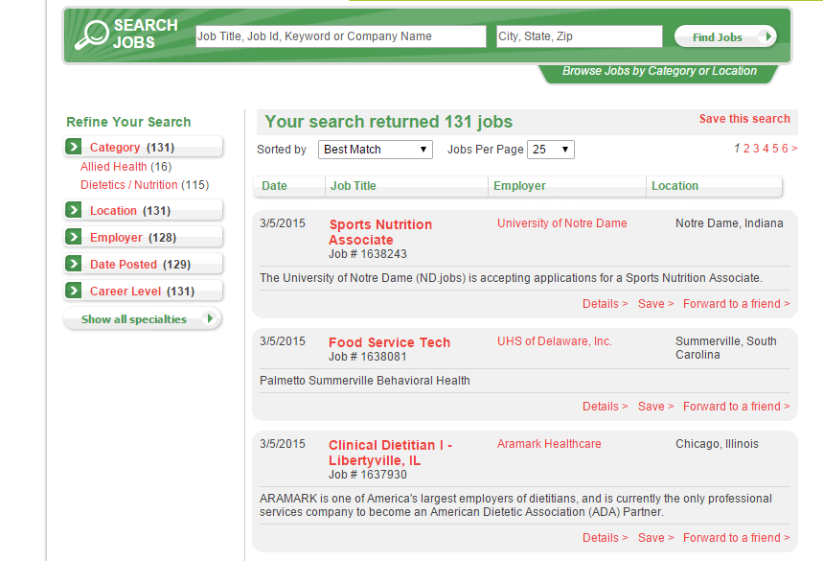
Jump Start Your Career
Notes:
[FOR STUDENTS]
As you consider the nutrition and dietetics field and begin to think about your path into the profession, the Academy is your primary resource once you begin to look for a job. From mentorship through the Academy’s eMentoring Program to finding a job through the Academy’s online job board, EatRight Careers, you can find the tools you need to launch your career in dietetics.
[FOR PROFESSIONALS]
If you are looking to find a mentor or give back to the nutrition and dietetics community, check out the Academy’s eMentoring program - only available to Academy members. Use the online platform to set up a mentor/mentee relationship that helps you take your career to the next level. While you are at it, check out the Academy’s online job board – EatRight Careers. Post a job and access dietetics professionals throughout the country. Or, set up an automatic alert to find your next dream job with the click of a mouse.

Slide 20
Savings on Publications
Notes:
Speaking of launching your career in dietetics, be sure to check out the Academy’s online store at www.eatrightSTORE.org where you can find a variety of publications including Launching Your Career in Nutrition and Dietetics. While Academy members typically receive a discount at the store, you do not have to be a member of the Academy to purchase from the Academy’s store. Be sure to check out Launching Your Career in Nutrition and Dietetics and much more today!

Slide 21
Learn more and join!
Members are leading the future of dietetics
Notes:
The food, nutrition and dietetics field is a fast paced and growing profession that impacts all of us. With so much new research and trends, it can be overwhelming to stay up-to-date on your own. With the Academy, you don’t have to. Academy membership allows you to concentrate on your career no matter what stage you are in. Turn to Academy membership throughout your nutrition and dietetics career. [PERSONALIZE AS NEEDED TO ENCOURAGE MEMBERSHIP.]
If you are interested in learning more, be sure to complete the roster that is circulating [PERSONALIZE AS NEEDED] with your contact information. By providing your contact information today, you will start receiving information from the Academy of Nutrition and Dietetics, including information on membership and member benefits. Be sure to visit www.eatrightPRO.org to find more information. I will also be handing out membership applications for those who are interested. Consider joining the Academy to get a jump start in the profession or take your career to the next level!

Slide 22
Academy Contact Information
Academy of Nutrition and Dietetics
Website: www.eatrightPRO.org
Email: membership@eatright.org
Academy Store
www.eatrightSTORE.org
Accreditation Council for Education in Nutrition and Dietetics (ACEND)
Website: www.eatrightACEND.org
Email: acend@eatright.org
Notes:
Visit the Academy’s website, or email membership@eatright.org for more information.

Slide 23
Questions?
Notes:
Thanks for letting me talk to you about the benefits of Academy membership.
Questions?

