Slide 1
Our Vision
Carrying the Flame through the Next Century

Slide 2
“An honorable past lies behind us,
a developing present is with us, and
a promising future lies before us.”
– Mary I. Barber
Academy historian (1931)

Slide 3
Our History and Legacy

Slide 4
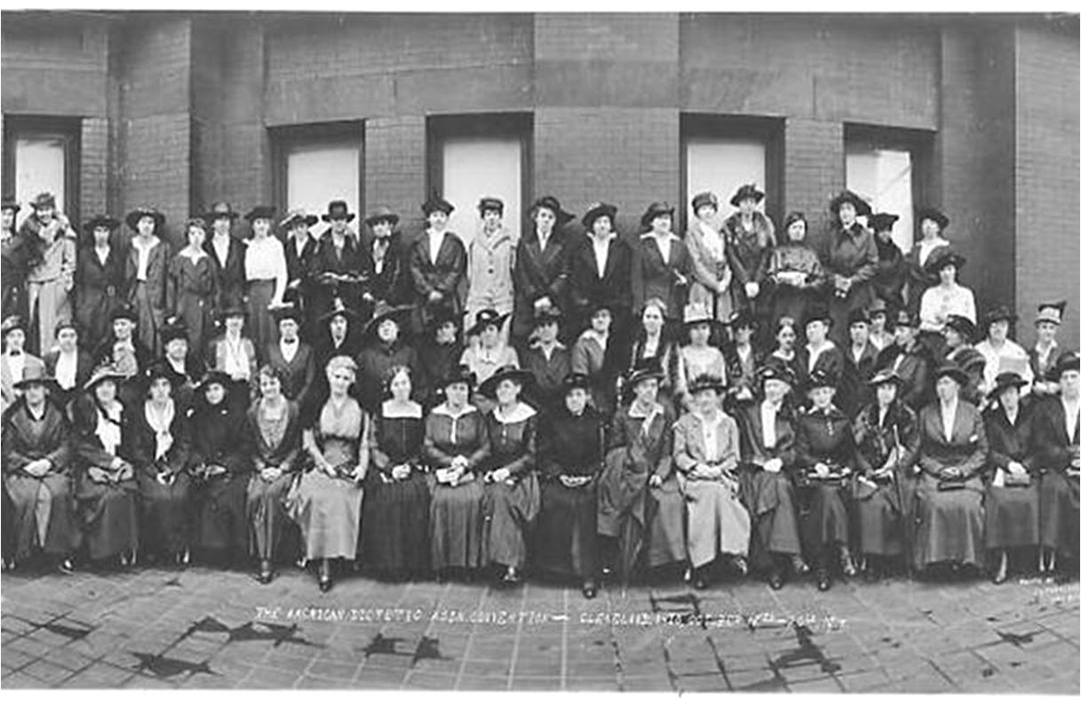
Our founders had a vision: to build a profession they believed would change the course of nutrition and health.
Notes:
The founders of the Academy of Nutrition and Dietetics had a vision: to build a profession they believed would change the course of nutrition and health.
During World War I, nutrition began to gain momentum as a field of science separate from medicine and nursing. Food scarcity in the U.S. and in Europe, and the resulting necessary food conservation efforts, brought the public’s nutritional status into the national spotlight.
The Academy’s first members shared a belief that helping people eat well would help solve a range of the country’s most pressing problems, from fighting disease and preparing soldiers for war to combatting poverty and strengthening the economy.

Slide 5
For 100 years, the Academy has honored that vision by working throughout food and health systems to improve the nation's health.
Association recognized as official accrediting agency for dietetic education
100,000 credentialed practitioners
American Dietetic Association founded
American Dietetic Association Foundation established
First National Nutrition Month
1917 | 1925 | 1940 | 1966 | 1968 | 1969 | 1970 | 1973 | 1978 | 1980 | 2012 | 2016
First issue of Journal of the American Dietetic Association
Membership reaches 20,000
First RD exam given
Membership reaches 35,000
Name changed to Academy of Nutrition and Dietetics

Slide 6
Nutrition has changed over the last century — and, as a profession, we are evolving to meet these changes.
The Academy seal symbolizes our commitment to benefit as many as possible.
Food and nutrition are still powerful tools of economic and social transformation.
Notes:
The field of nutrition has changed over the last century, and, as a profession, we are evolving to meet these needs, in clinical care, home health care, foodservice, community programs, prevention, communications, agriculture, business, research, education and private practice.
Our seal, adopted in 1940, built on the “benefit as many as possible” mentality. It symbolizes three important elements of the profession: a balance scale (science); a caduceus (link to medicine); and a cooking vessel (food preparation).
What was true at the start is still true today — food and nutrition have amazing power as a tool of economic and social transformation.

Slide 7
Our opportunity:
Choose a bold, purposeful way to continue this legacy with a new vision for the Academy’s Second Century — one that will not only elevate the profession and expand our reach, but do more to improve health around the world.
Notes:
As the Academy’s 100th anniversary approaches, the Academy Board of Directors directed a small committee of members and staff to explore a new vision for the Academy’s Second Century — one that would not only elevate the profession and expand our reach, but do more to improve health around the world.
The Academy’s executive team designed a strategic process for achieving this new vision, which has been enthusiastically embraced by the Academy BOD.
And, we need your counsel and guidance. As members and leaders, you provide the leadership that will kick off our Second Century, and your contributions — whether financial or through volunteering — will be vital to bringing this vision to life.
Since 1966, when it was established as the only charitable organization devoted exclusively to promoting nutrition and dietetics, the Foundation continues to be solely supported by donations which provide the vehicle for members to fund initiatives benefitting the health of the public.
Now, as we prepare for the future of the next century, funding from members and external stakeholders will continue to be critical to support both the innovative projects that emerge, along with the current initiatives of the Foundation to provide support for scholarships, research and public education, yet in a broader, more effective and global way.

Slide 8
The Time is Right

Slide 9
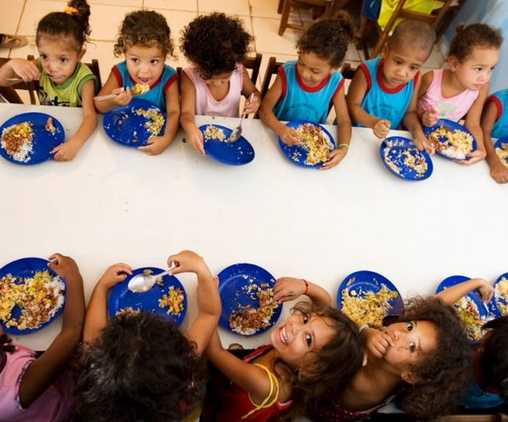
The world is at a critical moment for nutrition.
Some of the toughest health challenges of the next century will be linked to food access and choice:
Growing global population
Dual burden of under-nutrition and obesity
Ballooning chronic disease
Notes:
Since the Academy was founded, we have seen food and health systems evolve and become more global and complex. The ability to feed people and feed them well is a challenge we feel in our homes, our schools, our communities, our nation and around the world. The growing global population, dual burden of under-nutrition and obesity and ballooning rates of chronic disease all come with exorbitant costs.
As daunting as these challenges are, they present unprecedented opportunities for innovation and collaboration between nutrition professionals and other leaders, throughout food, wellness and health systems, as well as across disciplines.

Slide 10
There is global momentum for collaborative solutions.
Scaling Up Nutrition (SUN) Movement
Sustainable Development Goals
U.N. and WHO Decade of Action on Nutrition
Notes:
There is global momentum for collaborative solutions in food and nutrition – for all people, whoever they are and wherever they live.
In the last five years, the Scaling Up Nutrition (SUN) Movement has brought together governments, civil society, the United Nations, donors, businesses and researchers in a collective effort to improve nutrition globally.
In January 2016, the Sustainable Development Goals went into effect, with 17 transformative targets for all countries to work toward. Food and nutrition is at the top of the agenda – Goal #2 calls for an end to “all forms of malnutrition.”
In April 2016, the United Nations and the World Health Organization declared that the next 10 years will be the “Decade of Action on Nutrition,” calling for intensified action to eradicate malnutrition worldwide and ensure universal access to healthier and more sustainable diets.

Slide 11
The Academy has an opportunity to accelerate improvements in nutrition and health around the world, by building on our strengths and collaborating with other leaders.
Now is the time to chart the course we want for our profession in our Second Century.
Notes:
The type of change needed to solve our century’s greatest nutrition challenges can only happen when leaders across the food, health care and wellness spectrum work together.
The Academy must find ways to connect our strengths – starting with gold-standard food and nutrition expertise – with other leaders and organizations to contribute to a more comprehensive approach to good nutrition.
This also requires us to take a fresh look at everything from credentialing to practice to education in order to recalibrate for this new set of challenges.
We have often said that we want the Academy to be “at the table” in both local and global discussions about nutrition. We know our members have the talent and passion to make a difference – now is the time to look at where we can make a difference, and chart the course we want for our profession.

Slide 12
The Planning Process

Slide 13
Our Second Century planning process is collaborative, creative and deliberate – involving members every step of the way.
2016: Vision Year
2017: Mission Year
2018: Impact Year
Identify opportunities for influence and impact; reach out to members for input and feedback
­BOD endorses vision and makes recommendations to bring it to life
­Activate partnerships and external funding; launch innovation projects
Summit (Sept.): Shape potential vision; start to identify
projects and partners
­Plan “innovation projects”
and seek partners
Begin to make our new mark
on the world
FNCE (Oct.): Share proposed
Second Century vision with members with feedback opportunity; launch member fundraising campaign
FNCE (Oct.): Unveil final Second Century vision and announce partnerships and projects
Notes:
We are planning a collaborative, creative and deliberate process for developing our Second Century vision, and we invite members to participate every step of the way.
Vision Year (2016):
­The Academy and the Foundation are look internally and externally for future opportunities where the nutrition profession can have significant influence and impact. This includes meaningful input already gathered from the Board of Directors and House of Delegates.
­Convene a summit in September based on the Appreciative Inquiry method, seeking to build collaboration across food, wellness and health care systems. The summit provides an opportunity to strategize with Academy members and leaders, along with thought leaders across many fields and industries, to shape a potential strategic vision and start to identify innovative projects and partnerships to put this new vision into action.
A proposed Second Century vision unveils at FNCE 2016 for member feedback, along with a Second Century member fundraising campaign to support this new bold vision and the innovative projects that will expand and build upon the Foundation’s current programs and priorities that advance our profession.
Mission Year (2017):
­The Board of Directors commemorate our 100th anniversary by endorsing the Second Century vision and advancing strategic recommendations for the Academy to bring it to life.
­The Academy and the Foundation plan “innovation projects” related to the vision and seek partners for funding and implementation.
­At FNCE 2017, we will publicly unveil the Second Century vision and announce major partnerships and projects related to the vision.
Impact Year (2018):
­The Academy and Foundation activate partnerships and external funding announced at FNCE 2017 and launch innovation projects in the field.
­We begin to make our new mark on the world in 2018.

Slide 14
Second Century Input: Opportunity Areas
Over 125 internal and external interviews
Brainstorming with the Academy and Foundation Boards of Directors
The Council of Future Practice (CFP) Change Drivers and 2017 Visioning Report
August all-member survey
Presentations and Q&A sessions with Academy committees, councils and groups
Notes:
Member input is crucial to this process and we look to every area of our organization and profession to hear your thoughts on the future. We conducted over 125 interviews with members and individuals involved with food, nutrition and health; worked with the Academy and Foundation Boards of Directors and consulted the Change Drivers and 2017 Visioning Report from the Council on Future Practice.
Presentations and Q&A sessions with Academy committees, councils and groups, as well as input through the all-member survey and discussions with House of Delegate representatives, helped contribute to the focus of September’s Nutrition Impact Summit.

Slide 15
The Nutrition Impact Summary Overview
Convened 170 thought leaders, experts, innovators and strategic thinkers across the food, wellness and health care sectors
Participants explored opportunities to accelerate progress toward good health and well-being for all people
Participants …
Shaped the first draft of the new Second Century vision
Identified innovative solutions to today’s unique public health challenges
Brainstormed opportunities to change the global health trajectory through collaboration among key stakeholders on innovation projects
Notes:
The summit brought together 170 thought leaders, experts, innovators and strategic thinkers across the food, wellness and health care sectors that included external and member attendees.
Through small-group brainstorming, hundreds of ideas were turned into prototype concepts and, ultimately, draft innovation projects. Action plans were developed to advance the projects and post-Summit team calls were scheduled to keep these projects moving.
The Academy is working to develop screening criteria and the process for prioritizing innovation projects, along with recommendations, to present to the Academy and Foundation Boards of Directors in February 2017.

Slide 16
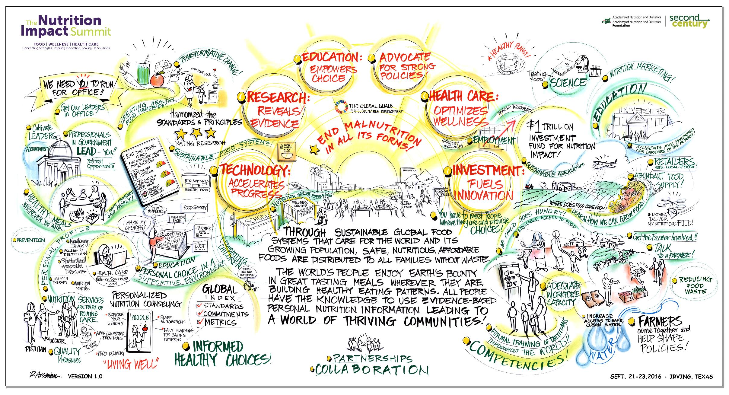
Notes:
A key premise moving forward together is that we must take a whole-system view as we identify ways to solve the challenges of global nutrition today and into our next century.
As we approach the initiative’s mission year in 2017, the Academy also commemorates our 100th anniversary. Not only will we have a centennial celebration in May in Cleveland, Ohio — where it all began — but the Board of Directors will endorse the Second Century vision and advance strategic recommendations for the Academy to bring it to life.
This proposed vision, endorsed by the Board, is a version that all of you will have the opportunity to reflect on and contribute to — from those members who participate in surveys, attended the Summit or share their version of the future here, today, at the Town Hall.
The Summit was an opportunity to work with leaders from across the food, wellness and health care sectors to create a shared vision and generate specific project ideas for how to make that vision a reality.
Although only one part of the this strategic input process, the giant brainstorm at the Summit has created a draft vision with a future where the world’s people enjoy earth’s bounty in great tasting meals wherever they are, building healthy eating patterns. And, all people have the knowledge to use evidence-based personal nutrition information leading to a world of thriving communities.
The core tenets of this proposed new vision:
Accelerating progress through technology
Revealing evidence through gold-standard research
Empowering consumers through education and creating an environment where the healthy choice is the easy choice
Advocating for stronger policies
Optimizing wellness through health care and customized nutrition solutions, and
Fueling innovation through investment

Slide 17
We have a plan to shape the future of the Academy – now we need your voice.
Be open to new ideas and ways of thinking
Bring your passion, energy and commitment to the profession
Ensure you understand the process and why your contribution to the Second Century matters
Notes:
The Academy has shown its commitment to the future of our profession by undertaking the development of our Second Century vision. It is our hope that Academy members will also commit to the future and be inspired by the new and innovative projects that come out of this planning process.
We want the whole Academy to be part of shaping our future and are confident that this process will get us there.
This experience will teach us all to stretch in new ways. We will ask you to be open to change, welcome different ideas and ways of thinking, and bring your personal passion, energy and commitment to the profession and its impact.
It is important for you to understand why we are undertaking this process, how it works and how the contribution of members is vital to the success of this new vision.
Academy groups, Affiliates, DPGs and MIGs, should consider donating, as well as challenge, motivate and encourage their memberships to do the same. As members, we must lead the way and be the first to show our financial commitment to the Second Century. Please join your fellow Academy leaders and contribute to the Second Century through the Foundation.

Slide 18
What Can You Do?
Continue to share your thoughts with the Second Century liaisons in your affiliates, DPGs and MIGs and reach out to your delegate in the House of Delegates to voice your perspective
Help spread the word online - #oursecondcentury
Email secondcentury@eatright.org with your questions and comments
Notes:
Your voices are necessary to create this new vision. We hope you will share your thoughts on your vision for the future of the Academy and the profession.
We have created a Second Century liaison for our affiliates, DPGs and MIGs, and we encourage you to reach out to them as well as to your elected delegates in the House to share your thoughts.
With your engagement in the process, we will not only create a future that incorporates our rich history, but a future where people and communities flourish because of the transformational power of food and nutrition.

Slide 19
Become a Member of the Second Century Giving Society
Champions $25 - $499
Leaders $500 - $9,999
Torchbearers $10,000 - $99,000
Founders $100,000 - $1M+
Visit www.eatrightfoundation.org/secondcentury
Notes:
As the Academy embarks on this endeavor, the Academy Foundation is well positioned to raise the necessary funds to support the Second Century, the new vision and the innovation projects, along with the current initiatives of the Foundation in a broader, more visible and global way. The support of Academy members is not only critical to promoting nutrition and dietetics through the Foundation, but also in funding these important programs.
The Foundation is proud to partner with the Academy on this bold new endeavor. As members of the Academy, this is your opportunity to make a significant impact on the future and donate to our Second Century. Become a member of the Second Century giving society.

Slide 20
Our commitment:
Create a Second Century vision that brings out the best the Academy and the Foundation have to offer — lifting the profession and expanding opportunities for all members.
Notes:
We are sincerely committed to this journey and hope you will be too. We will look back in a few years and we will know we were part of something transformational — the legacy of our future.
We are excited to get started and we will continue to share information as we continue in the process.

Slide 21
Questions?
Contact: secondcentury@eatright.org
Notes:
Q&A

